Slide 1
Development of Objectives

Slide 2
Development of Objectives
An objective is an intended result that an intervention sets out to achieve.
This is the stage at which you begin to define the results you want to achieve at different levels. The aim of the exercise is to define the desired future situation for all the identified problems, so that you can later identify those that the organization can realistically tackle.
It is again critical to conduct the process in a participatory way, involving the main stakeholders, including representatives of the people whom the intervention aims to help.

Slide 3
Objectives Tree
The is a tool to aid analysis and the presentation of ideas.
Its main strength is that it keeps the analysis of potential project objectives firmly rooted in addressing a range of clearly identified priority problems.

Slide 4
It will help to:
Demonstrate and describe the situation in the future if all the identified problems were remedied
Identify possible objectives (intended results) and verify the hierarchy between them
Illustrate and verify the causal (means-ends) relationships through a diagram
Establish priorities by: – assessing how realistic the achievement of some objectives may be and – identifying additional means that may be required to achieve the intended results

Slide 5
Basic steps in creating an objectives tree:
Step 1: Turn each of the problems in the problem tree into positive statements (“objectives”) by reformulating the negative situations as desirable positive situations, based on the needs that arise from the problems.
Reproduce the shape of the problem tree, substituting each problem with an objective.
Step 2: Check the logic (the cause-effect relationships) to ensure that the objective makes sense. Will the achievement of the lower-level objectives help achieve the higher level objectives? Modify the objectives, if necessary by:
Revising the statements to be more clear or accurate
Adding new objectives that are relevant/necessary
Removing objectives that are irrelevant or unnecessary

Slide 6
Suggested method for analysis
Step 1: Define potential solutions. Look at the objectives tree and group objectives together to define broad potential “solutions”. This is done by looking at which objectives are directly linked to each other in a cause-effect relationship..
During the earlier analysis stage, the potential merits or difficulties of different ways of addressing the problems may well have already been discussed. These issues and options must now be looked at more closely to determine the likely scope of the intervention before more detailed design work is undertaken.

Slide 7
Suggested method for analysis
Step 2: Select the most appropriate solution. Based on the set of solutions identified in the objectives tree, the team will now need to weigh up the different options available and choose the most appropriate one for the implementing team. This will then determine the scope of the intervention. There is a variety of tools to assist in this process. Two tools described here are the objectives analysis table and SWOT analysis. The objectives analysis table summarizes and organizes the information on each issue in a comparative table.
It is a useful tool to promote discussion and exchange among the team designing and implementing the intervention. As always, the quality of the analysis and the viability of the resulting decisions made will depend on the quality and legitimacy of the data being analysed (costs, prices, availability, local practices, etc.). The different criteria can be measured using numbers with 3 being the most positive and 1 the least positive); the solution that scores highest should be selected

Slide 8
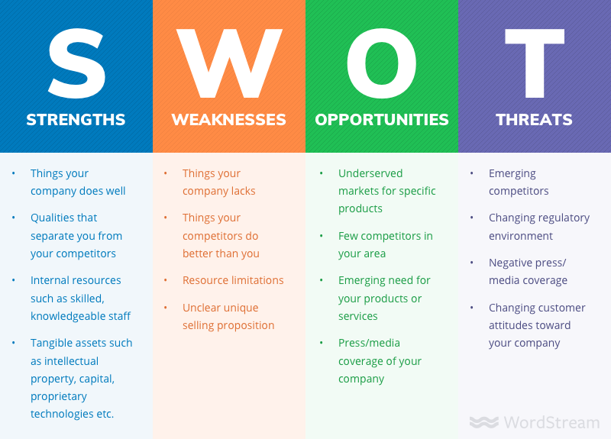
https://www.wordstream.com/blog/ws/2017/12/20/swot-analysis

Slide 9
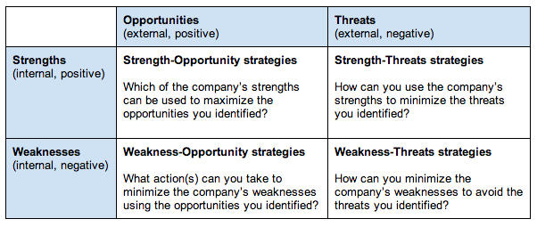

Slide 10
SWOT analysis for a community capacity-building strategy (example)
STRengThS | WeAKneSSeS
>Directly reaches the community actors > More sustainable as builds local knowledge > Relatively low cost as does not require expensive equipment | >Does not tackle wider institutional (government) issues > Does not address the need for improved disaster management mechanisms in the National Society
oPPoRTUnITIeS | ThReATS
Improves links with the community for other National Society projects/programs Improves National Society knowledge of community issues | Lengthy process to establish community rapport and precise needs Reliant on interest and willingness of the communities Time consuming to visit many communities
> >

Slide 11
Objective Analysis Table (example)
Which combination of objectives will address most effectively the needs of the target population? | Solution A School capacity building | Solution B Community capacity building | Solution C Local government capacity building | Solution D (combine solutions A & B)
Which objectives are compatible with the Red Cross Red Crescent’s fundamental principles, mandate and policies? | 2 | 3 | 1 | 3
Which combination of objectives does the organization and team have the capacity to address effectively? | 2 | 3 | 1 | 3
3. Are other organizations already addressing the problem? | 2 | 2 | 1 | 2
Constraints and risks: How vulnerable is the intervention to external factors? | 2 | 1 | 2 | 1
5. How can local ownership of the project best be supported? | 3 | 1 | 2 | 3
6. How can we take into account respect for local culture? | 3 | 2 | 3 | 3
7. What is/are the most cost-efficient option(s)? | 3 | 3 | 2 | 3
Total | 17 | 15 | 12 | 18

Slide 12
What is an Objective Tree Analysis
An Objective Tree is a Problem Tree that is transformed into a set of future solutions to the problems. Each negative problem is converted into an objective by rewriting it as a positive future statement.
Problem Statements | Objective Statements
Low agricultural production | High agricultural production
Lack of medical staff in rural areas | The number of medical staff in rural areas has increased
https://csnm.kku.ac.th/sites/default/files/public/learning/module/attachments/M3_S3_objective-tree_KSD_180916.pptx

Slide 13
What is an Objective Tree Analysis
As the Objective Tree is transformed from the Problem Tree: the analysis of problems in the Problem Tree from Problem/Project Identification (PPI) is the basis and starting point for the Objective Tree analysis.
The positive statements are in fact objective statements that can be presented in a diagram showing a means – ends hierarchy, the objective tree.

Slide 14
What is an Objective Tree Analysis
The analysis of objective tree aims:
Provide a clear overview of the desired future situation once problems have been identified and reformulate into objectives;
Verify the hierarchy of objectives;
Illustrate the means-ends relationships in a diagram.

Slide 15

2. What is an Objective Tree Analysis
Problem Tree
Objective Tree
Effects
Ends
Causes
Means
Image source: Clipartpenda
Negative Statements
Positive Statements

Slide 16
Reformulating Problem Statements into Objective Statements
Reformulating the problems into objectives has to be done very carefully.
If a statement makes no sense after rewording, write a replacement objective, or delete it, or leave the problem unchanged.
It is important to review the formulated objectives and the resulting objective tree.

Slide 17
Example

Slide 18
Reformulating Problem Statements into Objective Statements
Problem statement: “lack of adequate rain levels” cannot be transformed into “adequate rain levels available” because it is an unrealistic objective. We cannot intervene into the natural phenomenon by predicting or hoping that there will be adequate rain. This problem, however, could be rewritten as “irrigation system established and operational” which sounds more realistic and can be intervened.

Slide 19
Reformulating Problem Statements into Objective Statements
Problem statement: “river water quality is deteriorating” can be reformulated into “quality of river water is improved”.
Problem statement: “loss of confidence in public services” can be transformed into “people’s confidence in public services is restored”.
Problem statement: “public transportation is in bad condition” can be reformulated into “public transportation is kept in good condition”.

Slide 20
Reformulating Problem Statements into Objective Statements
Formulate the following problem statements into objective statements
Problem Statements
a. Farmers lack know-how in organic farming
b. Community members are not aware of HIV/AIDS prevention
c. High rate of alcohol consumption
d. High illiteracy rate of children from poor family background
e. Youth do not participate in community activities
f. Local community do not understand their roles and responsibilities in natural resources management
g. People do not save money for use in health care or emergency situation
h. Youth do not like to read
i. Community members do not want to buy health insurance

Slide 21
Steps in Formulating an Objective Tree
Step 1
Reformulate all negative situations of the problems analysis into positive situations that are desirable and/or realistically achievable
Step 2
Step 3
If necessary: revise statements; add new objectives if these seem to be relevant and necessary to achieve the objective at the next higher level; or delete objectives which do not seem suitable or necessary
Check the means-ends relationships to ensure validity and completeness of the hierarchy; cause-effect relationships in the problem tree are turned into means-ends linkages in the objective tree

Slide 22
Steps in Formulating an Objective Tree
The following diagram illustrates a transformation of a problem tree into an objective tree which uses “high staff turnover” as the main problem.
Problem Tree
Objective Tree
Delay in project delivery
High rate of recurring recruitment
Unstable team members
Project delivery meets the deadline
Low rate of recurring recruitment
Stable team members
High staff turnover
Reduced staff turnover
Unattractive salary package
Very high workload
Authoritarian managers
Better salary package
Reduced workload
Less Authoritarian managers

Slide 23
Steps in Formulating an Objective Tree
Summary of Formulating an Objective Tree from a Problem Tree
Problem Tree |  | Objective Tree
Relationship: Causes-Effects | Negative statements are rewritten into positive statements | Relationship: Means-Ends
Branches: Effects |  | Ends: Objectives
Trunk: Main problem |  | Trunk: Purpose/Objective/Outcome
Roots: Causes |  | Means: Objectives

Slide 24
Steps in Formulating an Objective Tree
Once complete, the objective tree provides a summary picture of the desired future situation, including the indicative means by which ends can be achieved.
As with the problem tree, the objective tree should provide a simplified but robust summary of reality. It is a tool to aid analysis and presentation of ideas/objectives.
Its main strength is that it keeps the analysis of potential project objectives firmly based on addressing a range of clearly identified priority problems.

Slide 25
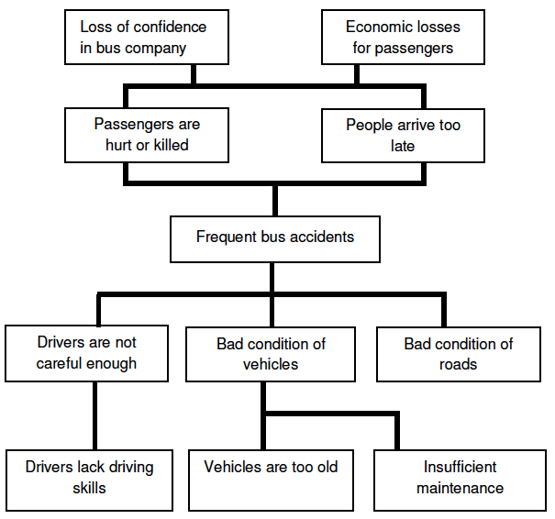
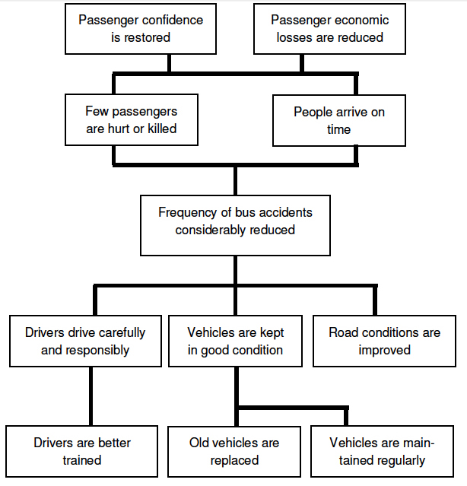
Examples of Objective Tree
An Example of Bus Accident
Effects → Goals
Problem Tree
Objective Tree
Effects → Goals
Main Problem → Purpose
Causes → Results
Causes → Activities
(adapted from Norad (1989) in Groenendijk (2003))

Slide 26
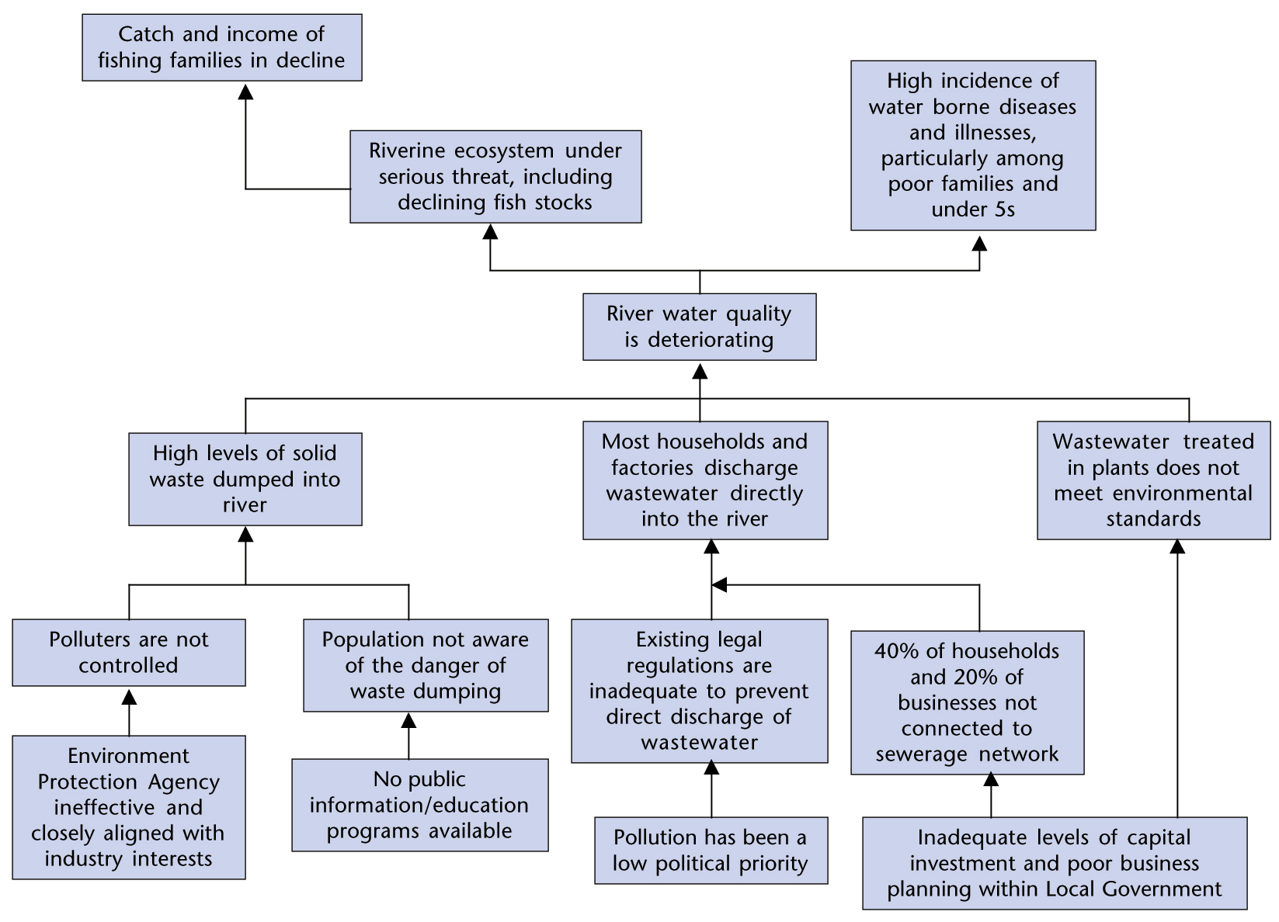
Examples of Objective Tree
Problem Tree
Effects
An Example of River Water Quality
(EC, 2004)
Main Problem
Causes

Slide 27
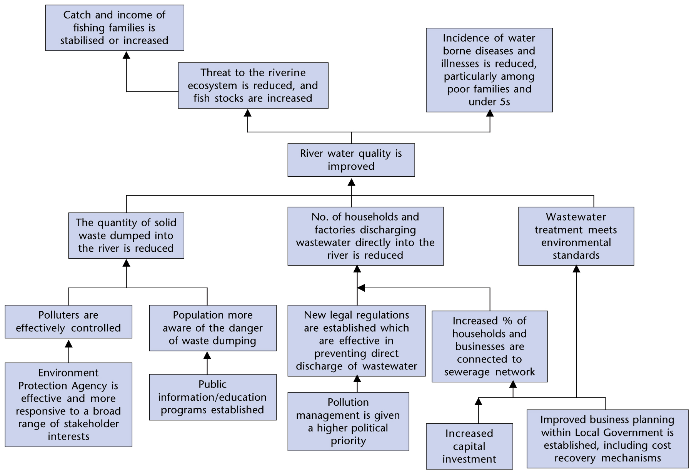
Examples of Objective Tree
Objective Tree
Goals/Overall Objectives
An Example of River Water Quality
(EC, 2004)
Purpose
Results
Activities

Slide 28
Class Activity
.

Slide 29
References
EC. (2004). Aid Delivery Methods: Project Cycle Management Guidelines. European Commission.
Groenendijk, L. (2003). Planning and Management Tools: a Reference Book. The International Institute for Go-Information Science and Earth Observation.
Johns Hopkins University. (2013). Module 4: Designing a Program. Johns Hopkins University.
Objective Tree Analysis. Retrieved on September 11, 2021 from https://csnm.kku.ac.th/sites/default/files/public/learning/module/attachments/M3_S3_objective-tree_KSD_180916.pptx

